Slide 1
LLD for Amazon Sales Data using Power BI
Name – Bhavesh Kumar Thakur
Date – 13 – 08 -2024

Slide 2
Introduction
This document outlines the low-level design for analyzing Amazon sales data using Power BI. The goal is to provide actionable insights into sales performance , Profitability and product trends.

Slide 3
What is Low-Level Design Document?
An LLD provides a detailed technical blueprint of the system, including data structures, algorithms, and workflows.

Slide 4
Scope
This project covers the extraction, transformation, and visualization of Amazon sales data.

Slide 5
Architecture
The architecture consists of data sources (Amazon sales data), ETL processes and Power BI for visualization.

Slide 6
Architecture Description
Data Description:
Sales Transactions: Order ID , Order Date, Ship Date, Units Sold, Unit Price, Unit Cost, Total Revenue ,Total Cost ,Total Profit .
Product Details: Item Type , Order Priority
Geographical Information : Region , Order priority
Data Transformation:
Cleaning: Correcting date Format & Data Types For Each Columns..
Aggregation: Summarize sales data by product, Geographically and time period.
Data Storage and Processing:
Load: Load Cleaned data into power bi .
Visualization : Creating Visuals
Deployment
Power BI Service: Publish reports to Power BI Service, configure refresh schedules, and set up user access.

Slide 7

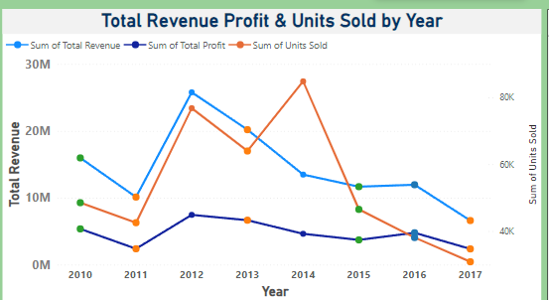
TEST CASE DESCRIPTION | EXPECTED RESULTS
Region | When clicked on the slicer, a dropdown should occur which has various parameters of the region .
Year & Month | When clicked on the slicer, a dropdown should occur which describes the parameters of the Year & Month.
Relation b/w Total Revenue , Profit & Unit Sold by Year. | Here a time series graph is shown of Year VS Total revenue , Profit & Unit Sold.

